Slide 1
Today
Recap weeks 14
One last blackboard derivation

Slide 2
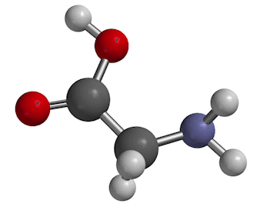
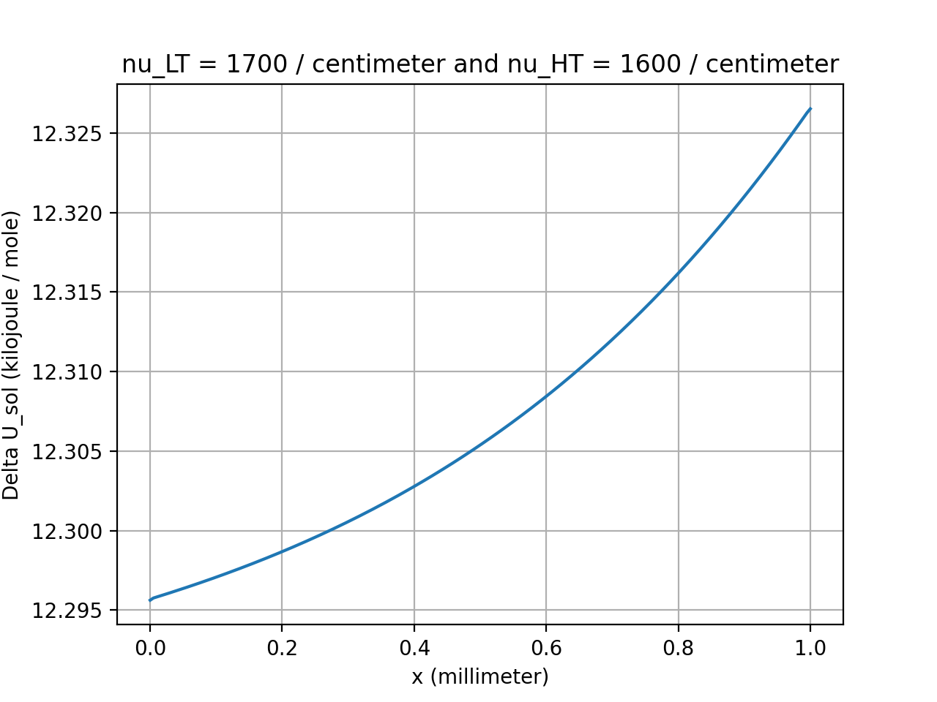
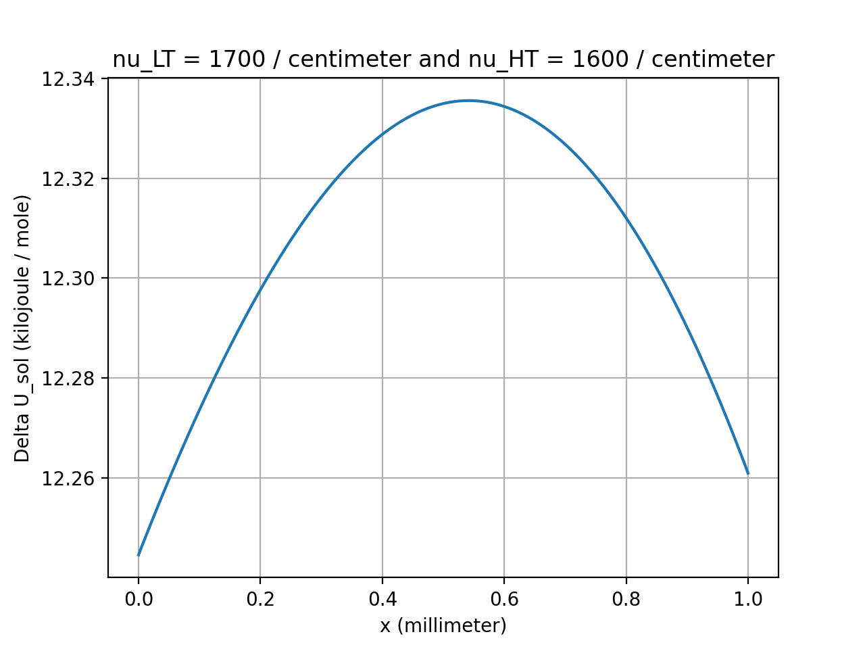
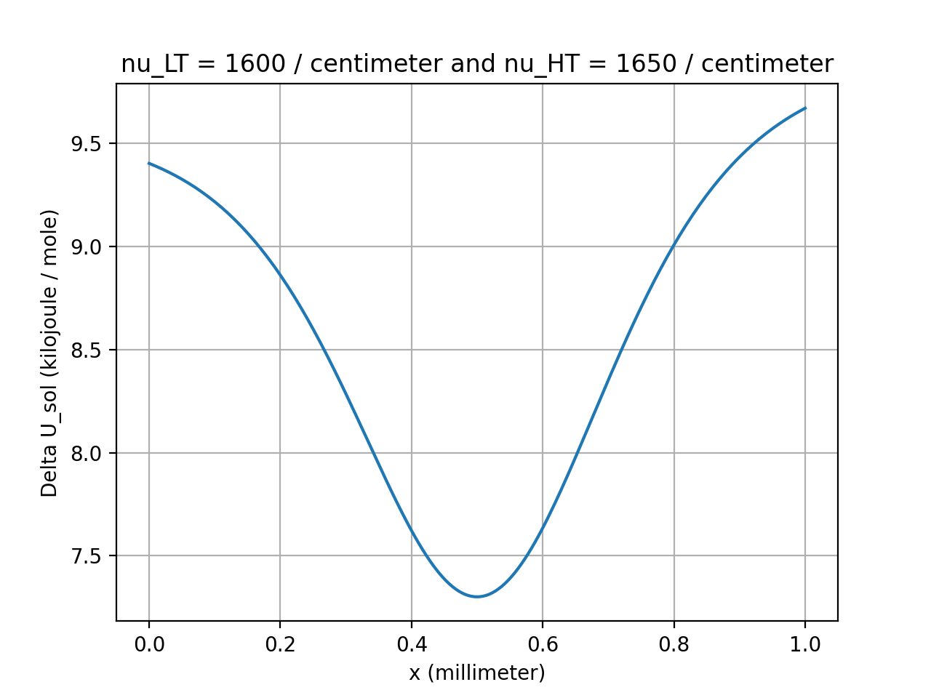
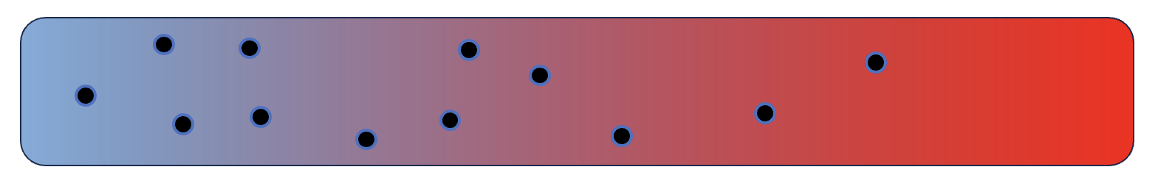
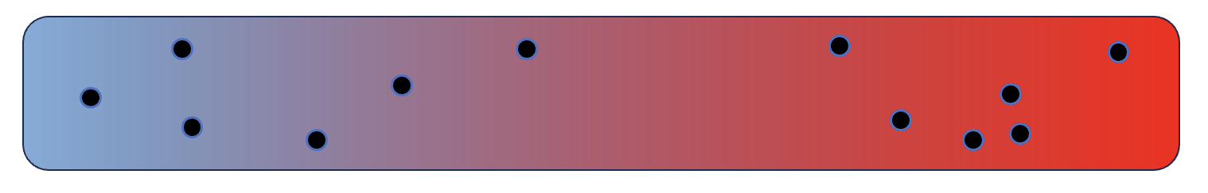
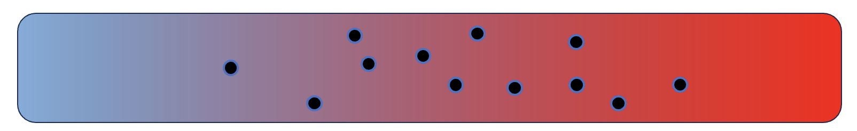
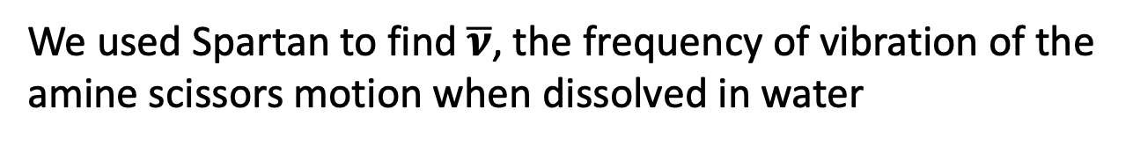
Week 14 – ${∆U}_{sol}$ and thermophoresis
We used Spartan to find $\overline{ν}$, the frequency of vibration of the amine scissors motion when dissolved in water
$${∆U}_{sol}$$
$${∆U}_{sol}$$
$${∆U}_{sol}$$

Slide 3
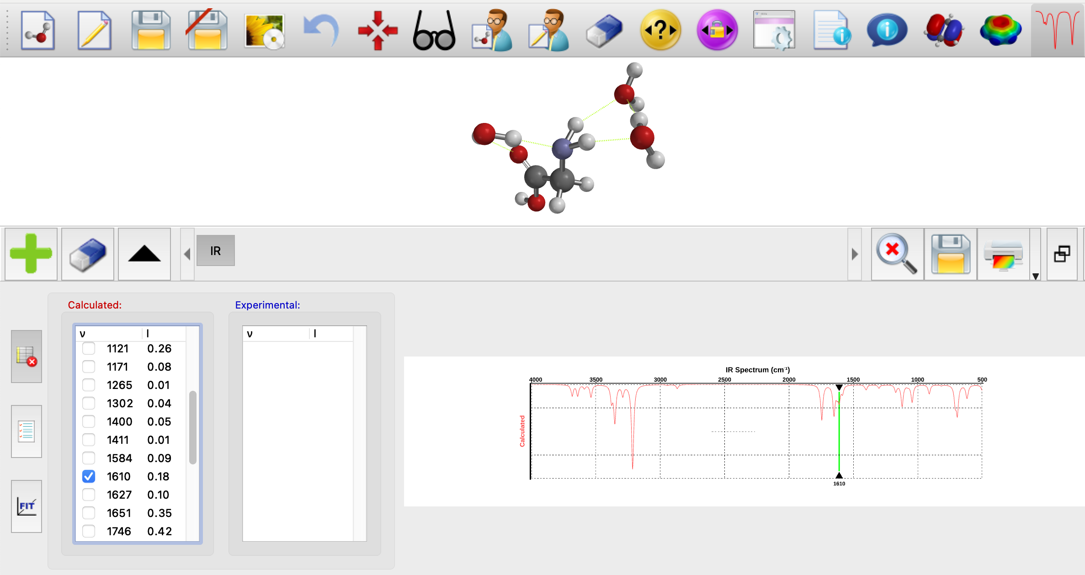
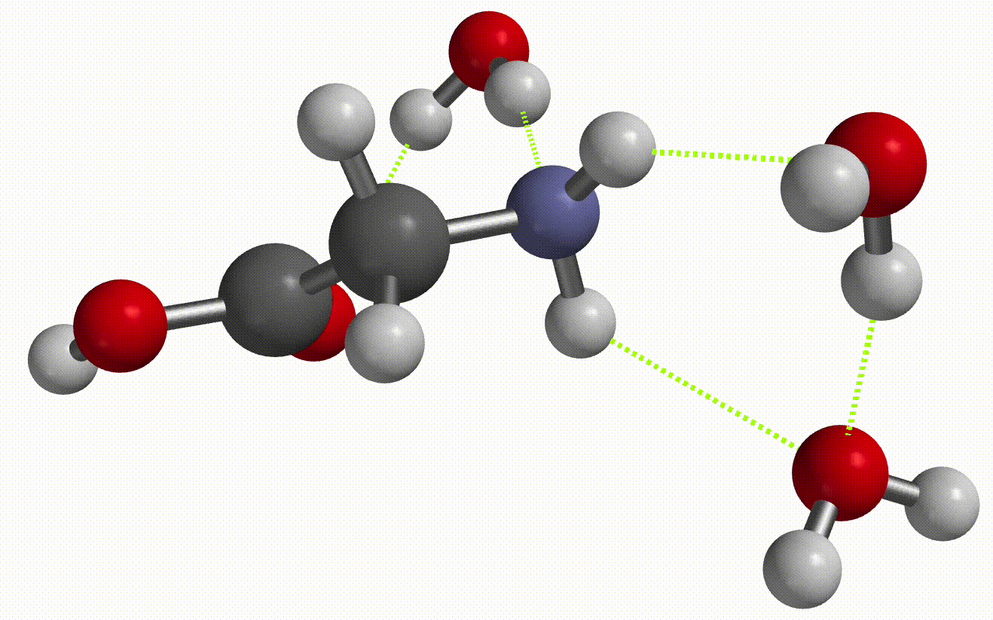
Week 14 – ${∆U}_{sol}$ and thermophoresis
$${\overline{ν}}_{LT}$$

Slide 4
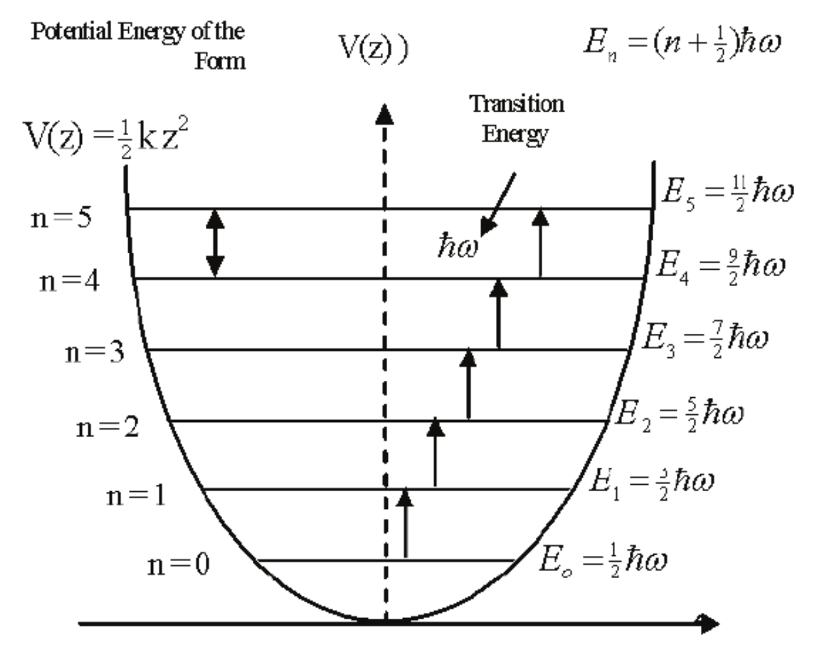
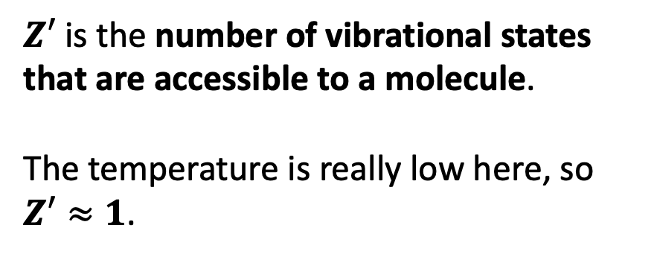
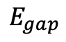
Week 14 – ${∆U}_{sol}$ and thermophoresis
$Z′$ is the number of vibrational states that are accessible to a molecule.
The temperature is really low here, so $Z′≈1$.
$$E_{gap}$$

Slide 5
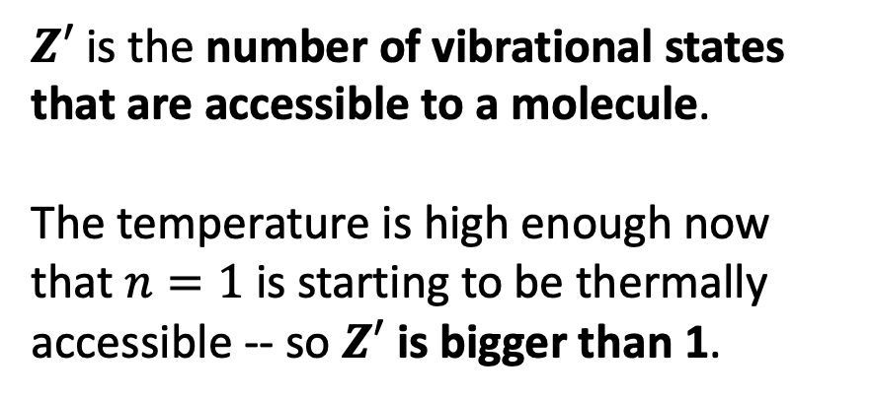
Week 14 – ${∆U}_{sol}$ and thermophoresis
$Z′$ is the number of vibrational states that are accessible to a molecule.
The temperature is high enough now that $n=1$ is starting to be thermally accessible -- so $Z′$ is bigger than 1.
$$E_{gap}$$

Slide 6
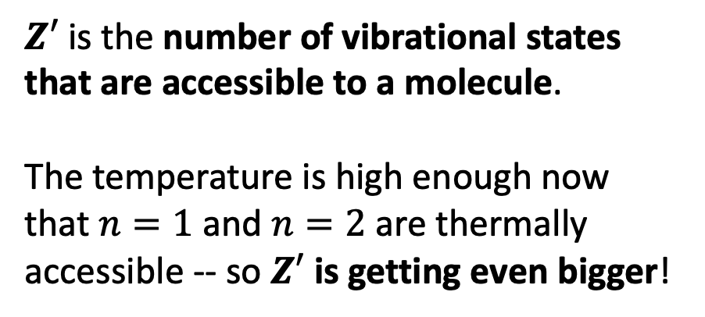
Week 14 – ${∆U}_{sol}$ and thermophoresis
$Z′$ is the number of vibrational states that are accessible to a molecule.
The temperature is high enough now that $n=1$ and $n=2$ are thermally accessible -- so $Z′$ is getting even bigger!
$$E_{gap}$$

Slide 7
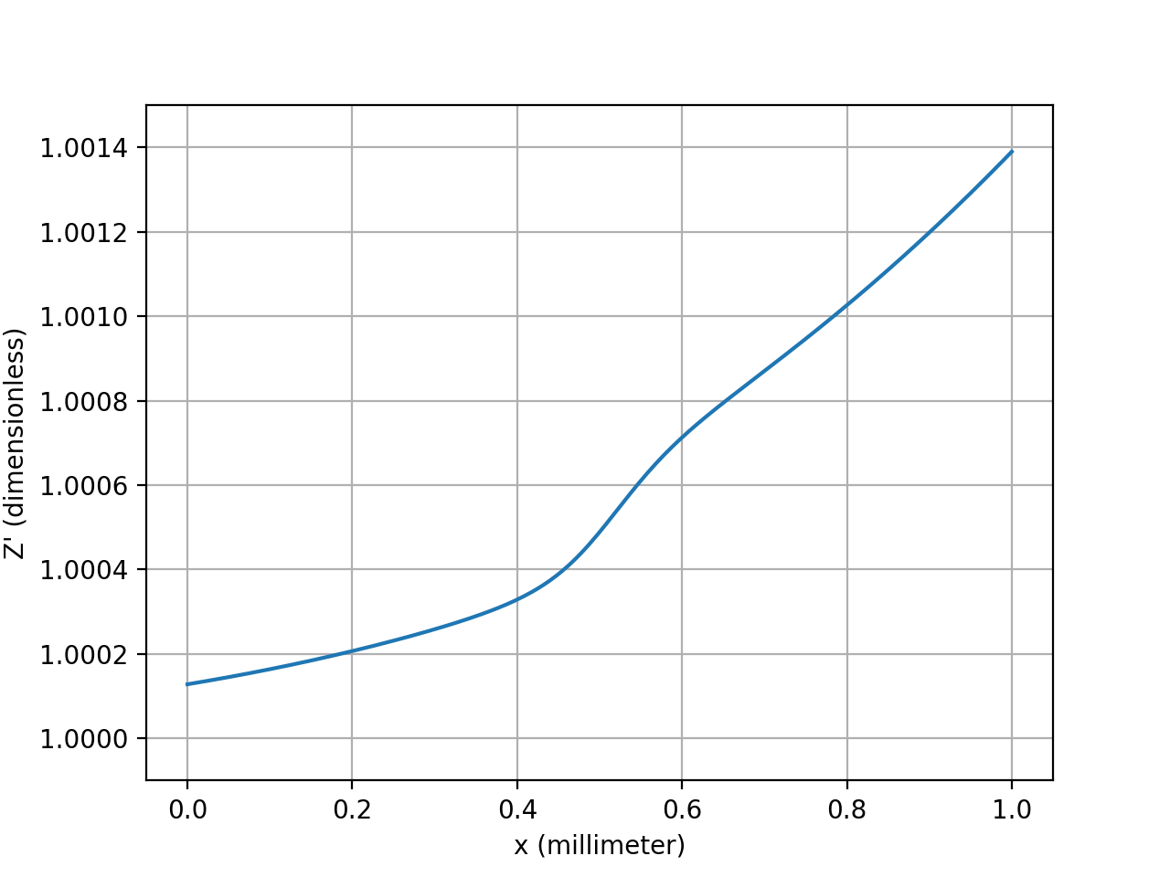
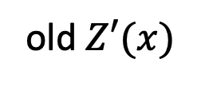
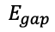
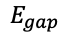
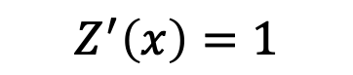
Week 14 – It actually looks like the approximation $Z^{′}≈1$ would do pretty well …
old $Z′(x)$
$$Z^{′}\left(x\right)=1$$
$$E_{gap}$$
$$E_{gap}$$

Slide 8
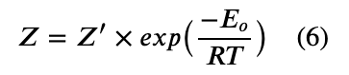
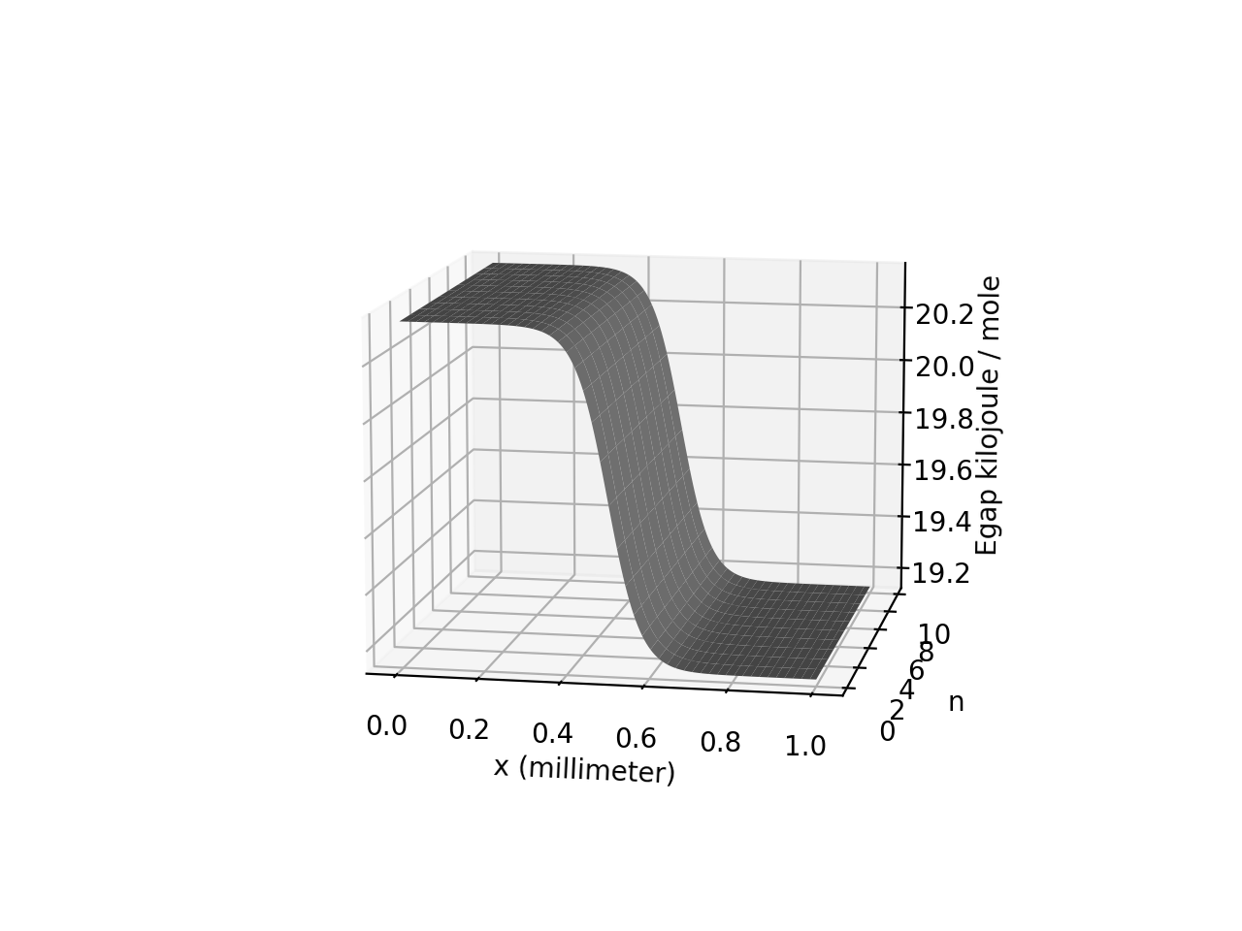
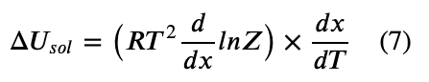
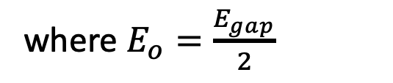
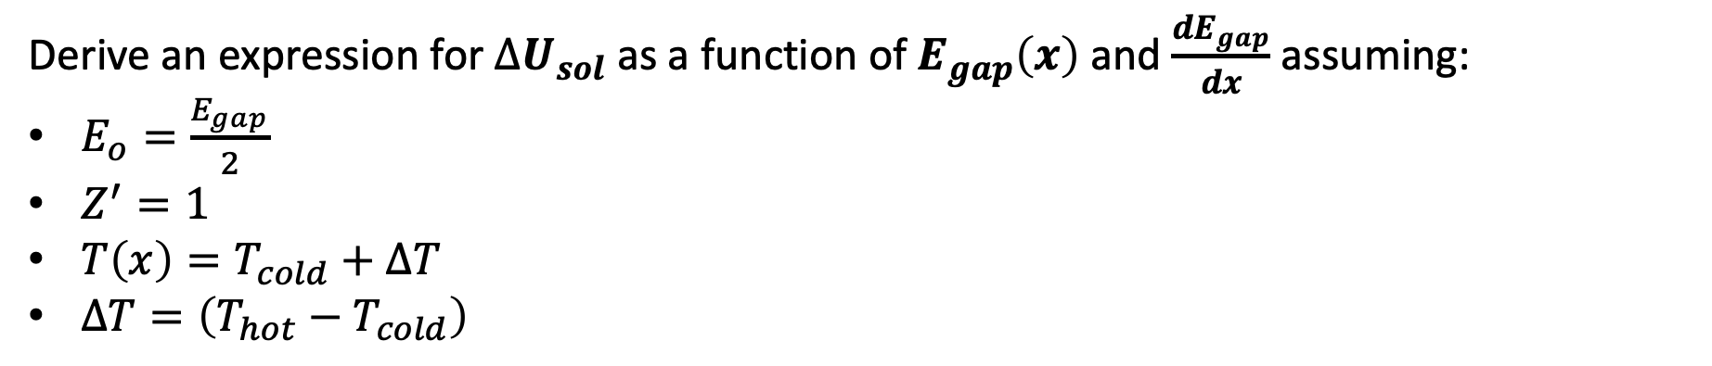
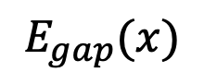
Week 14 – One last blackboard derivation … What if we say $Z^{′}=1$?
where $E_{o}=\frac{E_{gap}}{2}$
$$E_{gap}(x)$$
Derive an expression for ${∆U}_{sol}$ as a function of $E_{gap}\left(x\right)$ and $\frac{{dE}_{gap}}{dx}$ assuming:
$E_{o}=\frac{E_{gap}}{2}$
$Z^{′}=1$
$T\left(x\right)=T_{cold}+∆T$
$∆T=\left(T_{hot}−T_{cold}\right)$

Slide 9
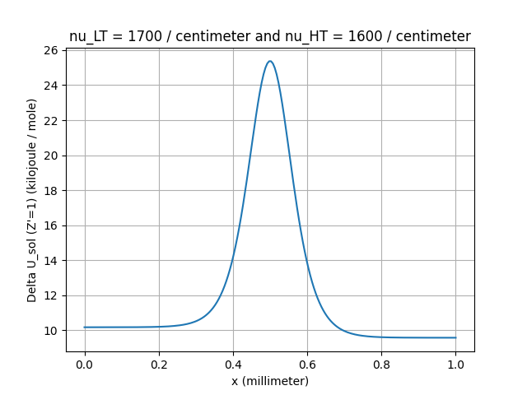
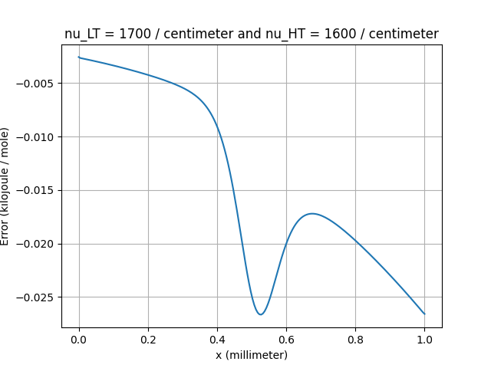
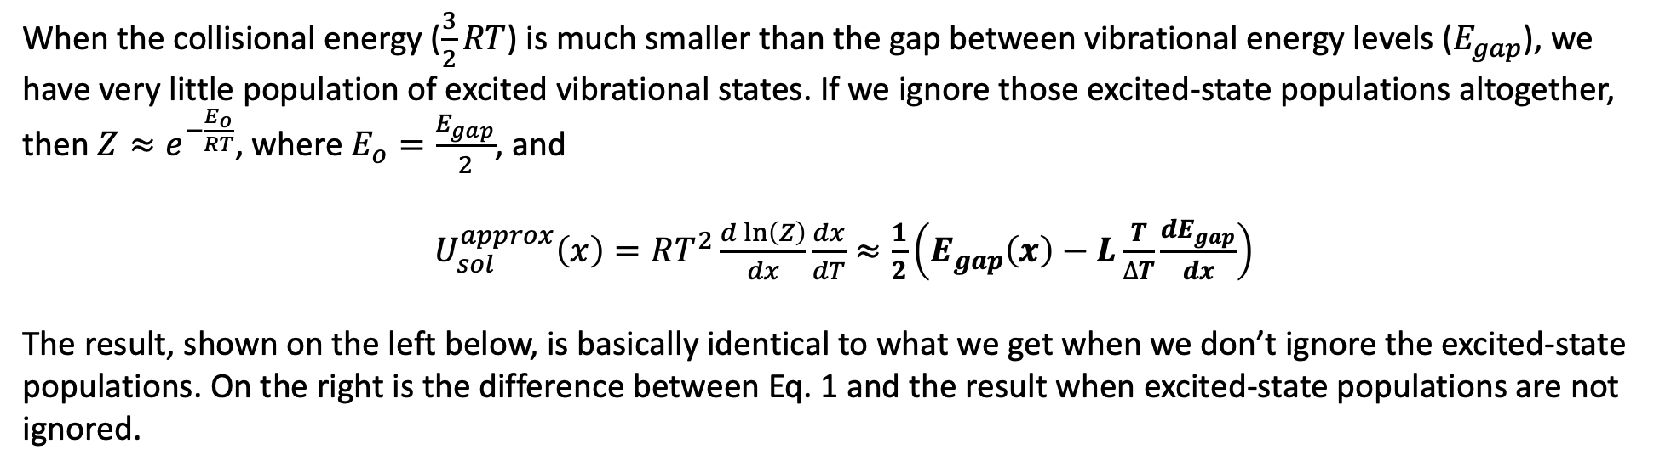
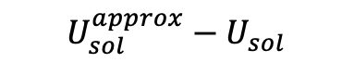
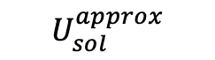
Week 14 – Results when we say $Z^{′}=1$?
When the collisional energy ($\frac{3}{2}RT$) is much smaller than the gap between vibrational energy levels ($E_{gap}$), we have very little population of excited vibrational states. If we ignore those excited-state populations altogether, then $Z≈e^{−\frac{E_{o}}{RT}}$, where $E_{o}=\frac{E_{gap}}{2}$, and
$U_{sol}^{approx}\left(x\right)=RT^{2}\frac{d\ln\left(Z\right)}{dx}\frac{dx}{dT}≈\frac{1}{2}\left(E_{gap}\left(x\right)−L\frac{T}{∆T}\frac{dE_{gap}}{dx}\right)$
The result, shown on the left below, is basically identical to what we get when we don’t ignore the excited-state populations. On the right is the difference between Eq. 1 and the result when excited-state populations are not ignored.
$$U_{sol}^{approx}−U_{sol}$$
$$U_{sol}^{approx}$$

